Slide 1
Ethos, Pathos, and Logos
The Power of Persuasion

Slide 2
Persuasive Speaking/Writing
The goal of argumentative/persuasive writing is to persuade your audience that your ideas are valid, or more valid than someone else's.
The Greek philosopher Aristotle divided the means of persuasion, appeals, into three categories--Ethos, Pathos, Logos.

Slide 3
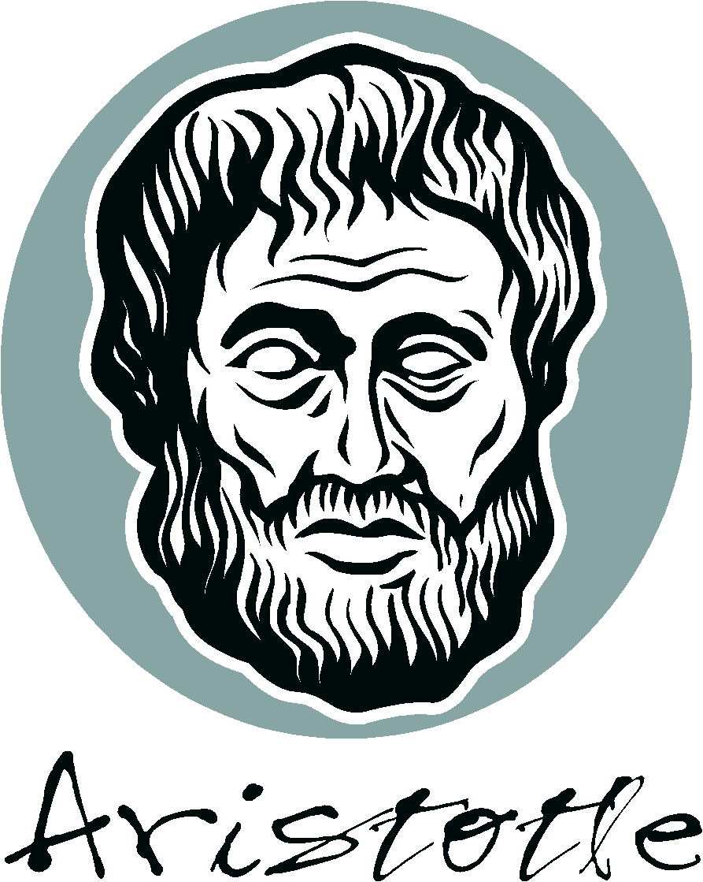
Aristotle taught that there are 3 main strategies in an argument
Ethos/Credibility
Pathos/Emotional
Logos/Logical

Slide 4
Rhetorical Chart
Author’s Purpose
Logos
Ethos
Pathos
The core of the rhetorical chart is purpose—What does the author/speaker
cartoonist/filmmaker/advertiser want the reader/listener/viewer to
Feel? Think? Do?

Slide 5
Ethos: Ethical Appeals the source's credibility, the speaker's/author's authority
How well an author/speaker presents him/herself
Questions for considering a writer’s ethos:
Does he or she seem knowledgeable? Reasonable? Trustworthy?
Does he or she treat their opponents with fairness and respect or do they take cheap shots?
Does he or she try and establish common ground with the reader/audience?

Slide 6
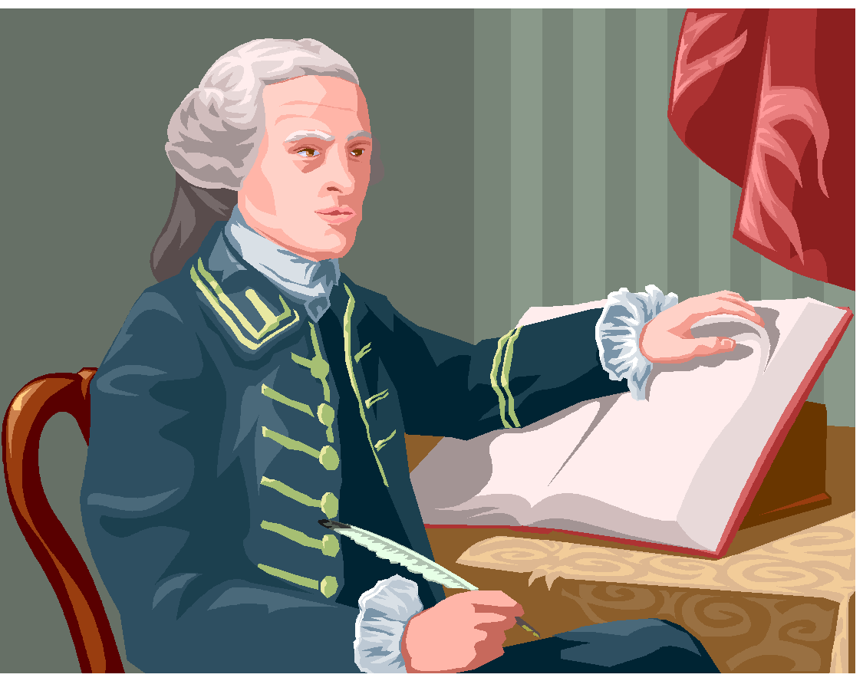
Ethos-Credibility
Appeals to the conscience, ethics, morals, standards, values, and principles.
Author or speaker tries to convince you he is of good character.
Qualified to make his claims.
Cites relevant authorities.
Quotes others accurately and fairly.

Slide 7
Examples of Ethos
"If, in my low moments, in word, deed or attitude, through some error of temper, taste, or tone, I have caused anyone discomfort, created pain, or revived someone's fears, that was not my truest self. If there were occasions when my grape turned into a raisin and my joy bell lost its resonance, please forgive me. Charge it to my head and not to my heart. My head--so limited in its finitude; my heart, which is boundless in its love for the human family. I am not a perfect servant. I am a public servant doing my best against the odds." (Jesse Jackson, Democratic National Convention Keynote Address, 1984)

Slide 8
Pathos: Emotional Appeals the emotional or motivational appeals; vivid language, emotional language and numerous sensory details.
How well the author taps into the audiences emotions
Questions for considering a writer’s pathos:
Does the topic matter to the audience?
Does the writer include anecdotes?
Does the writer appeal to your emotions, memories, fears, etc.?
Is the emotional appeal effective or overwhelming?
Is the writing overloaded with facts and figures?

Slide 9
Pathos-Emotional Appeal
Appeals to the heart,
Emotions,
Sympathy,
Passions,
Sentimentality,
Uses imagery, figurative language,
Carefully constructed sentences.

Slide 10
Example of Pathos
"Hillary Clinton used a moment of brilliantly staged emotion to win the New Hampshire Democratic primary . . .. As she answered questions in a diner on the morning before the election, Mrs. Clinton's voice began to waver and crack when she said: 'It's not easy. . . . This is very personal for me.'

Slide 11
Logos: Logical Appeal the logic used to support a claim; can also be the facts and statistics used to help support the argument.
How well the author uses text and evidence to support own argument or claims. Should be well organized.
Questions for considering a text’s logos:
What is being argued or what is the author’s thesis?
What points does the author offer to support their thesis?
Are ideas presented logically?

Slide 12
LOGOS-Logical Argument
Involves facts or
Research
Quoted authorities
Cause and Effect information
Analogies or comparisons
Common sense information
Shared values
Precedents

Slide 13
Example of Logos
Rational choice theory in political science has made much of the fact that it is seemingly irrational to vote in a large-scale election. This is because the probability that your single vote will determine the outcome is generally very close to zero, while the act of voting entails some small but real costs. Even in a close election like Florida in 2000, an individual’s vote would really “count” only if the margin of victory was exactly one vote.

Slide 14
Rhetorical Devices
What does rhetoric mean anyway?
Rhetoric is the art of discourse (conversation), that aims to improve the facility of speakers or writers who attempt to inform, persuade, or motivate particular audiences in a specific situation.

Slide 15
Parallelism
Writing structures that are grammatically parallel helps the reader understand the points better because they flow smoothly.
Ask not what your country can do for you, ask what you can do for your country. –JFK
If there is anyone out there who still doubts…who still wonders…who still questions.

Slide 16
Repetition
Repetition can be effective in creating a sense of structure and power. In both speech and literature, repeating small phrases can ingrain an idea in the minds of the audience.
Yes, we can, to opportunity and prosperity. Yes, we can heal this nation. Yes, we can repair this world. Yes, we can.
I had a dream…

Slide 17
Figurative Language
Language used to express a relationship between unlike things using similes and metaphors.
…airless dungeons…links of iron…Romans are but sheep…

Slide 18
Rhetorical Question
A question to consider and not to answer out loud.
Who here is so base that would be a bondman?... Who here is so rude that would not be a Roman? –Julius Caesar

Slide 19
Hypophora
Asking yourself questions, and then answering them.
This is intended to give the audience your answer.
I will win! Why? Because I have faith, courage and enthusiasm.

Slide 20
Antithesis
A figure of speech in which sharply contrasting ideas are juxtaposed.
It was the best of times, it was the worst of times, it was the age of wisdom, it was the age of foolishness, it was the epoch of belief, it was the epoch of incredulity, it was the season of Light, it was the season of Darkness, it was the spring of hope, it was the winter of despair, we had everything before us, we had nothing before us, we were all going direct to Heaven, we were all going direct the other way. (Dickens, A Tale of Two Cities)

Slide 21
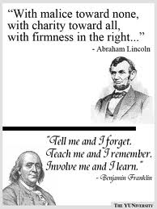
Tricolon
A tricolon is a list of three, or a sentence in which there are three parts or clauses. The cumulative effect of three has a powerful effect on an audience.

Slide 22
Polysyndeton
Using several conjunctions in close succession, especially where some might be omitted—used to stress the importance of each item.

